Slide 1
MEASURES FOR IN-SAMPLE EVALUATION

Slide 2

2 - PARAMETERS
MSE (MEAN SQUARE ERROR)
R – SQUARED ($R^{2}$)

Slide 3

STEPS TO FOLLOW
SUBTRACTING : $(y=y_{1}−ŷ_{1})$
SQUARING : $(y^{2})$
MEAN / AVERAGE OF ALL THE ERRORS BY ADDING THEM ALL TOGETHER & DIVIDING BY THE NUMBER OF SAMPLES
mean/average = $\frac{adding all of them}{no. of samples}$

Slide 4
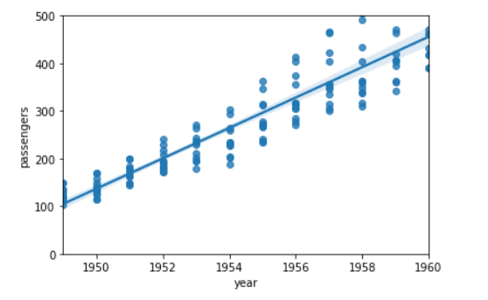

EXAMPLE
$y=200 −150=50$
${(y}^{2})={50}^{2}=2500$
ASSUME:
mean/average = $\frac{25000}{500}=50$

